Slide 1
Negotiation Update UGFA Bargaining Team Scott Gillies (Chief Negotiator), Scott Colwell, Mary DeCoste, Sue Hubers, David Josephy, Herb Kunze
NEGOTIATIONS
Thursday May 22, 2014

Slide 2
TODAY’S AGENDA
Team Introduction
Bargaining Progress
Bargaining Objectives
UGFA - Summary of Proposals
Management - Summary of Proposals
Q&A

Slide 3
TEAM
Scott Gillies (Library, Chief Negotiator)
Scott Colwell (MCS, CBE)
Mary DeCoste (SOLAL, COA)
Sue Hubers (UGFA)
David Josephy (MCB, CBS)
Herb Kunze (Math/Stats, CPES)

Slide 4
PROGRESS (1)
Milestones
April 28, 2014 – Start of Bargaining
June 12, 2014 – Spring provincial election
June 30 2014 – Contract expiry
No. of Meetings = 7 (Hours at Table = 25)
Notes:
-Note significant opportunity/risk because of changeover in Senior Administration

Slide 5
PROGRESS (2)
Review Objectives - Listed in priority order
Bargaining is an iterative process
UGFA Language Proposals available to Members on request
Notes:
Iterative process – proposals can change very quickly – providing a snapshot in time > very difficult to predict
State members can come to the house to see proposed language if they wish

Slide 6
UGFA OBJECTIVES (1)
Strengthen Collegial Governance
Defend Members’ Job Security
Propose Innovative Solutions for Long-Term Pension Sustainability
Bargain Fair Compensation
Workload: Strengthen Safeguards and Increase Transparency
Improve T&P/CAP Processes
Correct Collective Agreement Processes
Notes:
-TOP priority across colleges in Members Survey
-Consistent and persistent undermining of faculty/academic staff’s role and involvement in academic planning and governance
-ONLY PROTECTION for collegial governance IS the Collective Agreement, including placing limits on Board and Senate’s ability to negatively affect Members’ Terms and Conditions of employment

Slide 7
UGFA Proposals (1)
Collegial Governance:
Preamble (Art. 1) – increased transparency
Management rights (Art. 5) > Mgmt to be ‘reasonable’; limit impact of Senate on Members’ terms and conditions
LOUs on implementing recommendations arising from the CAUT Investigation of OVC
Chairs (Art. 20) and Librarian Admin Appointments (Art. 27)
Notes:
-Lets review our current proposals develop on the 7 bargaining objectives
-Close to agreement on Chairs – greater clarity on nomenclature, requirements to implement search judiciously and

Slide 8
UGFA Proposals (2)
Limiting Administration imposition:
Working conditions (Art. 17)
New protections on software and systems (privacy, need to consult, sufficient resources)
Complement language (Art. 15)
Proposed to retain current level of faculty, librarians and veterinarians
Notes:
Stress that we are fighting to forestall future admin imposition of technology to the detriment of members (future Sedona-like iterations)
Importance of privacy (email)
Technology and software are 21st century terms and conditions of employment and we need to bargain on them!

Slide 9
UGFA Proposals (3)
Protect Job Security :
Fighting hard to get Mgmt proposals on Article 24* off the table
*Transfers, Redeployment or Buyouts of Faculty and Librarian Members Due to Restructuring or Academic Program Reorganization
Notes:
Team has gone as far as we could reasonably go in terms of counter-proposals to get Article 24 off the table (to the limits of our bargaining mandate)
More information on future slide when we discuss Mgmt proposals

Slide 10
UGFA Proposals (4)
Workload Improvements:
Transparency
Maintain current Department teaching norms
Scheduling improvements for Libs and Vets
Language for clinical faculty
Choice of tool in teaching evaluation; use scores only for T&P
Notes:
Solidify past gains – make permanent LOUs on teaching assignments
Need to increase transparency, particularly as workload norms exist only at Dept/school/unit level

Slide 11
UGFA Proposals (5)
Compensation:
Salary
Modeled on University announced budget projections (2-3%/annum)
Maintain current salary structure
Improve career increment to ON comparator standards (median award to $3K)

Slide 12
UGFA Proposals (6)
Compensation:
PDR ($200/year); removal of limit of # of claims
Pension
Maintain current member contributions
LOU proposed framework to evaluate and recommend transfer/merger options to JSPPs
Benefits
Maintain current benefit levels
Propose modest improvements (dental restorative, vision, paramedical, counseling, tuition waiver for non-faculty)
Notes:
Pension – very reasonable – recognizing substantial concessions in past bargaining
Only substantive change is now required – timelines must coincide with end of solvency relief period (2017) – meet provincial political mandates (three pt. platform)
Benefits – reasonable list of improvements to move us to median levels in Ontario – make permanent gains on past issues – counseling and tuition waiver

Slide 13
UGFA Proposals (7)
Correct collective agreement processes:
T&P/CAP articles (Art. 21, 28 & 33): clarity on committee procedures, ‘direct knowledge’ and embed ratings language
Investigations and discipline (Art. 39): tighten timelines and confidentiality
LOUs (LOU #4, 5, 6, 7, 8, 9, 12, 14 and 15)
Notes:
We are close on T&P and CAP articles – have some gains tentatively signed off: some improvements – however, with the outcome of the arbitration on eCV, the language will be hard coded into these articles including (hopefully) the arbitrated language on what Members are required to do in good faith to meet the confirming requirements

Slide 14
ADMIN PROPOSALS (1)
Limited set of proposals (7 + LOUs)
HOWEVER, the most regressive and punitive first set of Admin proposals that have ever been tabled to UGFA
Notes:
STRESS that the proposals tabled this round in the Admin package was the most punitive and regressive (and perhaps also aggressive) that the UGFA has ever witnessed

Slide 15
ADMIN PROPOSALS (2)
Workload
Right to change Member DOE without consent (but…willing to be ‘reasonable’)
Faculty with higher teaching loads (60%+) can be assigned to teach in each semester
Notes:
Long series of discussions on the Mgmt DOE – there may be isolated issues of ‘misalignment’ but there are tools in the current CA and they do not use them
Difference between Members not doing jobs and being unreasonably denying change and performance management
On faculty appts. With higher teaching loads – clear they want the right to assign teaching in EVERY semester – remove the right to an R&D semester AND deem teaching semester to have been taken as R&D

Slide 16
ADMIN PROPOSALS (3)
Workload (2)
No departmental teaching norms or protection (‘need the right to run the university without unnecessary restrictions’)
Unilateral right to determine mode of course evaluation and release of teaching scores
Vets (Libs?) – removal of scheduling provisions
Notes:
Make connection in first point that changes to DOE, removal of all dept. teaching course load norms is linked to future changes predicated on budget cuts
Fewer Members means more teaching for everyone, AND an increased emphasis on needed to change individual DOEs to meet anticipated higher teaching loads

Slide 17
ADMIN PROPOSALS (4)
Compensation
Salary
Near 0% ATB/scale increases for 4 years
“Good” is the new “Bad” = No ACI for Good
For less than Good – can deny ATB/scale increase
Merit increases (performance increments) – lump sum (non-permanent)
Improve increases for promotion
Notes:
Never expect to see good money on the table to start
Offer is really sad – could not understand where it came from
Realized that the Admin is trying to impose the same salary restraint parameters on UGFA members as they had imposed on them by Prov. Gov’t

Slide 18
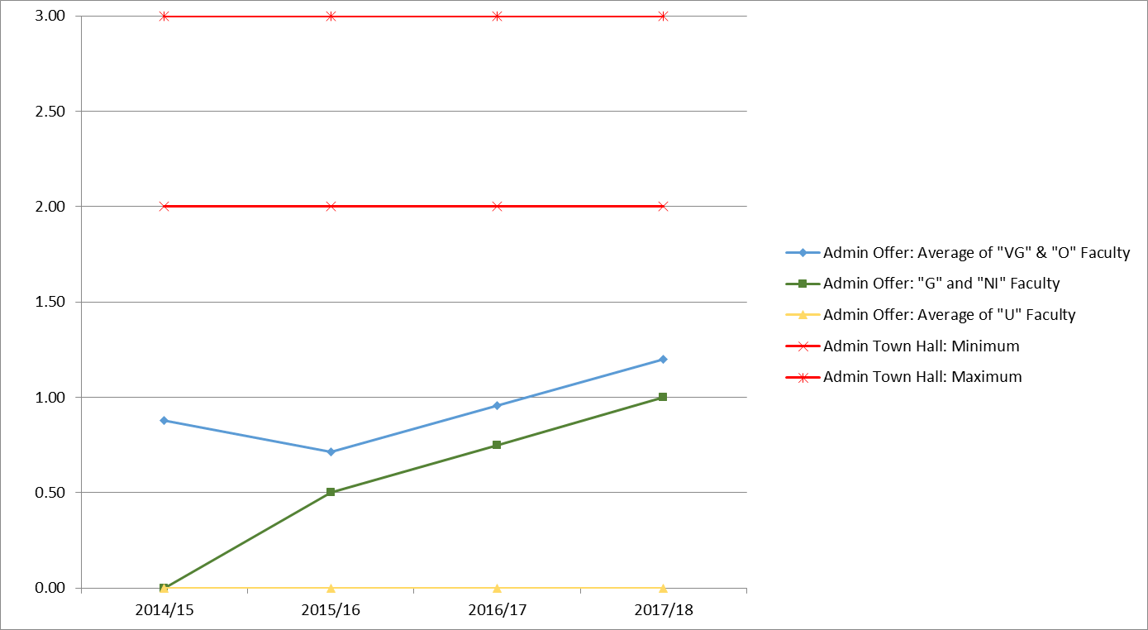
Salary Figures
Notes:
Look at the impact of the Admin proposals
Their first offer WELL below their own announced compensation framework

Slide 19
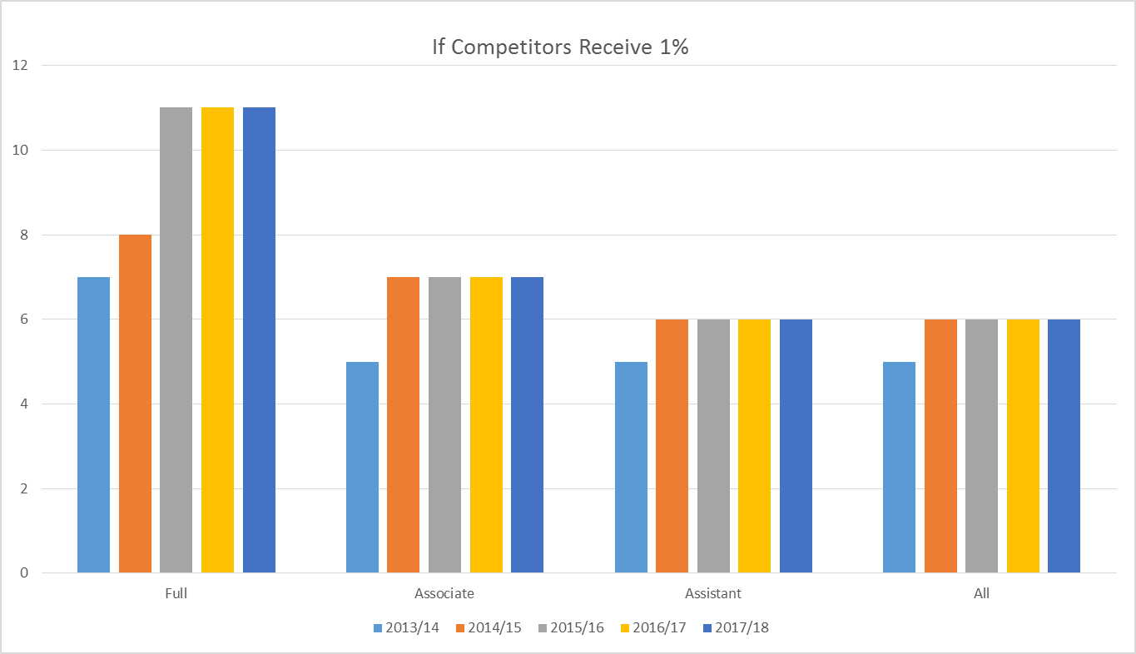
Fifth Place Slippage
Notes:
Impact of the Admin proposals over time as a function of UG average salaries over 4 years in the Ontario system (change to 5th place)
Thanks to Herb for pulling these slides together

Slide 20
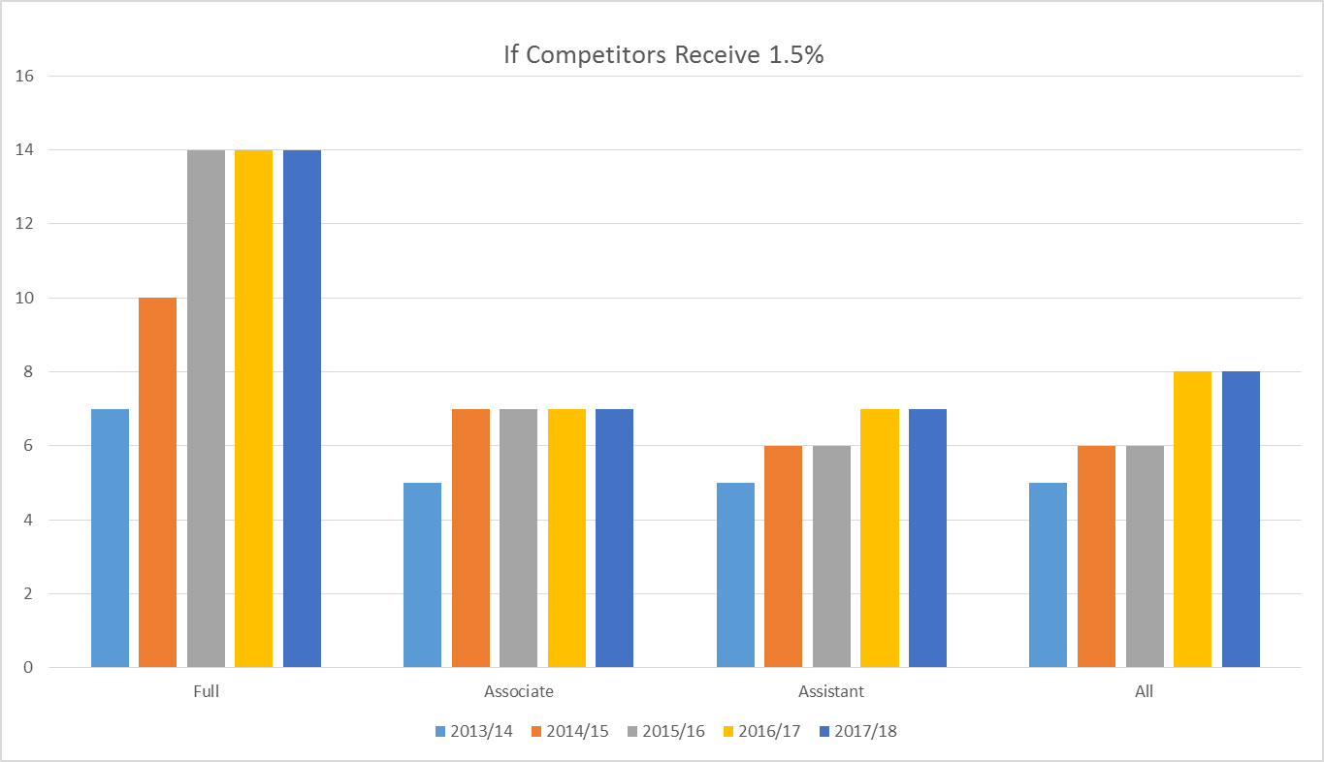
Fifth Place Slippage

Slide 21
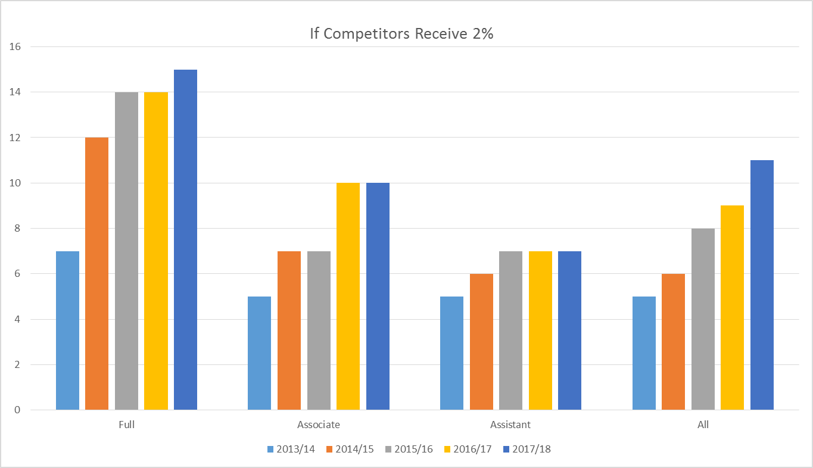
Fifth Place Slippage

Slide 22
ADMIN PROPOSALS (5)
Compensation
Benefits
Possible erosion of certain benefits (discussions vs. proposed language
Pension
Members assume larger share of past deficit
Increased Member contributions
Partial removal of future indexation
Notes:
Explain funny business on benefits proposals
Pension is sad and not sure that they really mean what they put on the table

Slide 23
ADMIN PROPOSALS (6)
Study/Research Leave
20% cut in pay for Study/Research Leaves after first leave
Vacation
Claw back up to two weeks of carry forward
Association Rights
Cut in University support for UGFA release time for officers
Notes:
Here is a package of really mean spirited and frankly ill-considered proposals
Attacks to sabbaticals and Association’s ability to represent Members are mean spirited and we have described these as insulting to the Team

Slide 24
ADMIN PROPOSALS (7)
Article 24*
Right to lay off UGFA Members under program reorganization
*Transfers, Redeployment or Buyouts of Faculty and Librarian Members Due to Restructuring or Academic Program Reorganization
Notes:
Significance of the Mgmt proposals cannot be overstated – removal of all job protection (from redundancy of a program to redundancy of a Member)
Administration anticipates employee reductions as a result of the announced budget reductions
UGFA team tried on several occasions to get the Admin to withdraw – to the limits of what we viewed as our mandate
Proposals still on the table – they did offer to remove IF we accepted ALL of the terrible proposals on 18 and we removed a number of our proposed articles
If this Article remains on the table, there cannot be agreement

Slide 25
QUESTIONS - APPROVAL
Summary – We need your support and help to get a fair agreement!
Questions; Discussion

